Slide 1
Data Analytics Uses Cases Examples

Slide 2

DATA ANALYTICS USE CASES EXAMPLES
1. A Comprehensive Dashboard of Key HR Metrics and Performance Indicators
2. Web Scraping Tool for Second-Hand Car Sales
3. Mapping Banking Services: An Analysis of Branch Locations and Demographics
4. Assessing Candidates’ Experience through Sentiment Analysis
5. Geospatial Analysis of Labor Catchment: Assessing Employment and Demographic Patterns

Slide 3









A Comprehensive Dashboard of Key HR Metrics and Performance Indicators
Client Challenge
Our Solution
Outcome
The client wanted to have an automated Human Resource Dashboard to track, analyze and report on HR KPIs.
The firm was looking for:
The company decided to use Infomineo’ Data Analytics service as a solution to cover:
The client benefited from Infomineo Data Analytics service on multiple fronts:
Stable and Reliable Data:
Correction & Standardization of ERP data, eliminating manual file usage
Significant enhancement in accuracy +75% for Critical Data Elements
Organizational Efficiency: 1 HR FTE reallocated to other tasks due to streamlined data processes.
Companywide Transformation: The client embarked on a data transformation journey, partnering with Infomineo to create alsol financial dashboards
Data Quality & Consistency problems between the various Data sources
Effective and quick solution
Dashboard creation reflecting the HR Team’s needs
Smooth integration with its existing ERPs
Ad-hoc deliverables: Dictionaries, Creation of Metadata, Data Quality Process
Lower cost than subscribing to a dedicated HR Dashboard tool

Slide 4

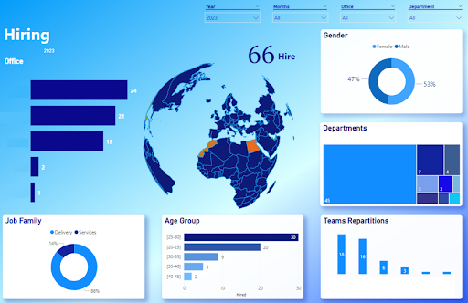

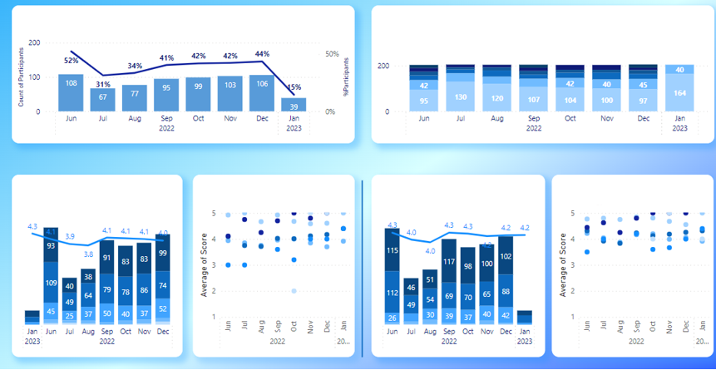
A Comprehensive Dashboard of HR Key Metrics and Performance Indicators
Achievements
Elaborated Data Model: Gathering and transforming data from 5 different tools
Automated Source Reports: Created 14 source reports and automated their extractions using APIs, ensuring efficient and timely data retrieval.
Automated Data Quality Checks: Implemented automated data quality checks based on predefined business rules, ensuring data integrity and accuracy.
Extensive Dashboards: Delivered a comprehensive report comprising 30 dashboards, featuring +150 graphs, and including +50 KPIs.

Slide 5

Web Scraping Tool for Second-Hand Car Sales
Client Challenge
Our Solution
Outcome
To analyze the secondhand automobile market in Morocco the client needed access to relevant and accurate data.
The client chose to use data of the country’s leading C2C e-commerce platform.
The firm was looking for:
Infomineo’ s Data Analytics team addressed the client’s challenges by developing :
The client benefited from Infomineo Data Analytics service on multiple fronts:
User friendly Web Scraping Tool
The client received a user-friendly web scraping tool equipped with a user interface, enabling tailored requesting.
Expanded Data Extraction Capabilities
Datasets were created from the e-commerce platform across various cities and categories, enhancing data extraction capabilities.
Time and Resource Savings
The client achieved significant time efficiency in the data collection process, resulting in resource savings.
Comprehensive Data Collection Strategy
Establishing a robust data collection framework and implementing efficient methodologies to gather the required data.
User-Centric Interface Design
Crafting a user-friendly graphical user interface (GUI) that simplified the data collection process for the client
Data Quality Assurance
Implementing rigorous cleaning and preprocessing techniques to ensure the integrity and reliability of the collected data.
An efficient and consistent way to regularly collect data from an e-commerce website
Create a database with the data collected daily to avoid bias of unsold items

Slide 6
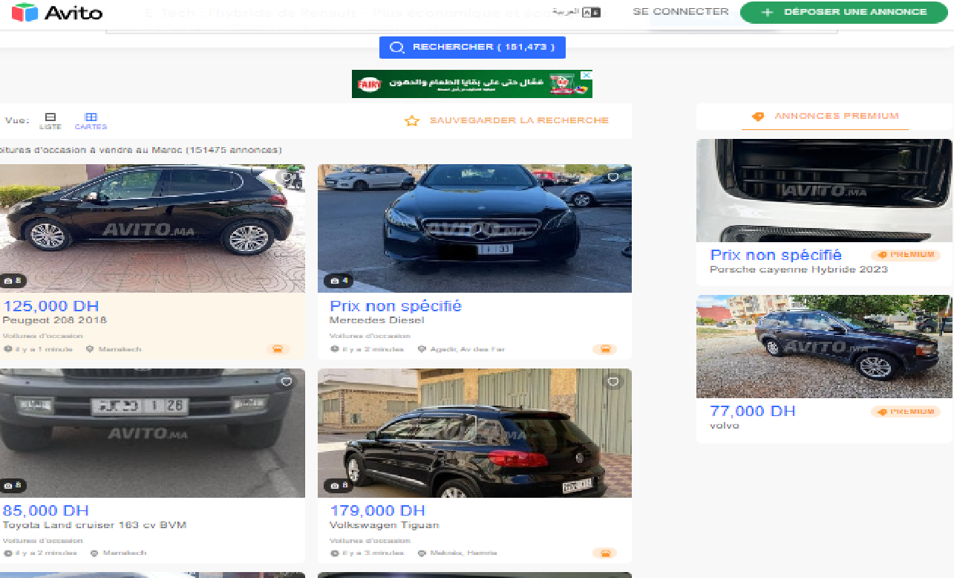

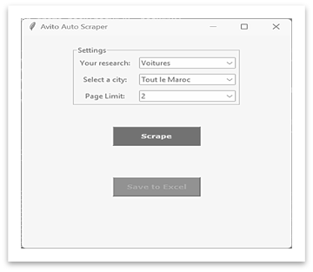
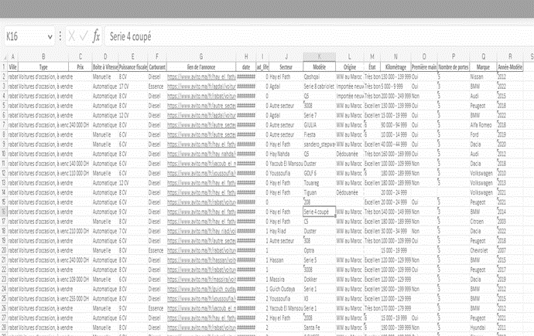
Web Scraping Tool for Second-Hand Car Sales
Streamlined Data Collection Methodology
Establishing Data Collection Requirements
Identification and selection of +15 core data elements crucial for analysis, enabling the client to perform comprehensive insights generation.
Developing a Data Collection Plan and Storage
Implementation of a daily automated process to pull car listings from across the country, creating an up-to-date database for analysis purposes.
Designing a graphical user interface (GUI)
Development of a user-friendly GUI that allows the client to effortlessly select specific car brands/models and collect data on demand.
Cleaning and preprocessing the data
Built of robust cleaning and preprocessing techniques to enhance data quality and usability, including removing duplicates, correcting inconsistencies, and standardizing data formats.

Slide 7


Mapping Banking Services: An Analysis of Branch Locations and Demographics
Client Challenge
Our Solution
Outcome
To analyze the banking sector in Casablanca the client needed to visualize the banking network of the major banks of Morocco and to map this network with other demographic data.
The firm was looking for:
Infomineo’ s Data Analytics team addressed the client’s need by:
The client benefited from Infomineo Data Analytics service on multiple fronts:
Comprehensive Visualization
A heatmap of major banks' branches, overlaid with the city's districts to incorporate district-level information such as population and unemployment rate.
Localized Market Insights
A detailed map focusing on city neighborhoods, providing localized information on the price per square meter to identify areas of untapped potential.
An enhanced map for each branch, incorporating relevant data like proxies for traffic signs to assess the surrounding environment.
Identifying Necessary Data and Establishing Collection Criteria
Leveraging fuzzy matching to compare data from different sources
Geocoding the location data and visualizing it on a geospatial map
Comparing the agencies' locations with socio-economic and demographic data
An efficient approach for gathering data on banking agency locations, socio-demographic characteristics, and restaurants information’.
A solution that would enable analysis of trends across different data categories by visualizing them on a geospatial map.

Slide 8

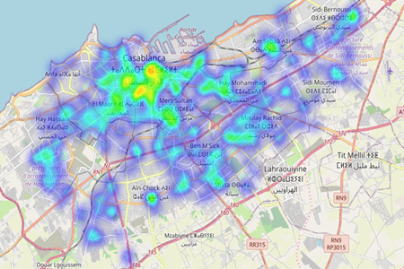
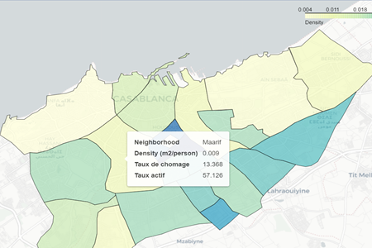
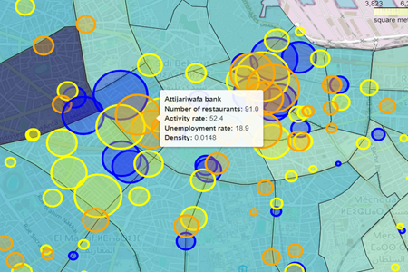
Mapping Banking Services: An Analysis of Branch Locations and Demographics
Heatmap of banking agencies in Casablanca
Districts’ Socio-demographic data
Streamlined Data Collection Methodology
Branch Location Data: Using Google API to collect up-to-date information on branch locations.
Socio-demographic Data: Gathering socio-demographic data from the economic government agency website, leveraging GeoJsons and GeoDataFrames for city districts' insights
Micro Zone Analysis: Dividing the city map into +150 micro zones for localized view. Average price per square meter data collected from biggest Moroccan FSBO website through web scraping and fuzzy matching.
Traffic Sign Proxies: Development of Two traffic sign proxies within 300m radius of each branch for capturing relevant information.
Restaurant Data: Leveraging Google API to collect restaurant data near each branch, aiding local environment analysis.
Surface Share of Built Constructions: Calculating surface share of built constructions using ESA World Cover program and high-resolution land cover map
Neighbourhood average price per square meter
Enhanced Map with all information collected
+
Attijariwafa Bank
Banque Populaire
Bank of Africa

Slide 9


Assessing Candidates’ Experience through Sentiment Analysis
Client Challenge
Our Solution
Outcome
The client need to analyze a large volume of candidates' feedback data collected during the recruitment process and sought an automated solution.
The firm was looking for:
Infomineo’s Data Analytics team addressed the client’s challenges by:
The client benefited from Infomineo Data Analytics service on multiple fronts:
Data-Driven Decision-Making
Re-evaluate the recruitment procedures.
Identify specific areas where improvements could be made.
Enhance the candidate experience at the global, regional, country, and departmental levels.
Advanced Analytics Perspectives
The AI-powered tool offered the client a fresh perspective on harnessing advanced analytics within their operations
Conducting sentiment analysis to analyze candidate feedback and extract the overall sentiment.
An automated tool to analyze candidate feedback, replacing the manual analysis process.
Leveraging AI-powered text summarization through OpenAI, the extract key insights from candidate comments and displaying the corresponding specific comments.
Generate meaningful insights to enhance the candidate recruitment experience.
Creating a Dashboard for a streamlined analysis

Slide 10
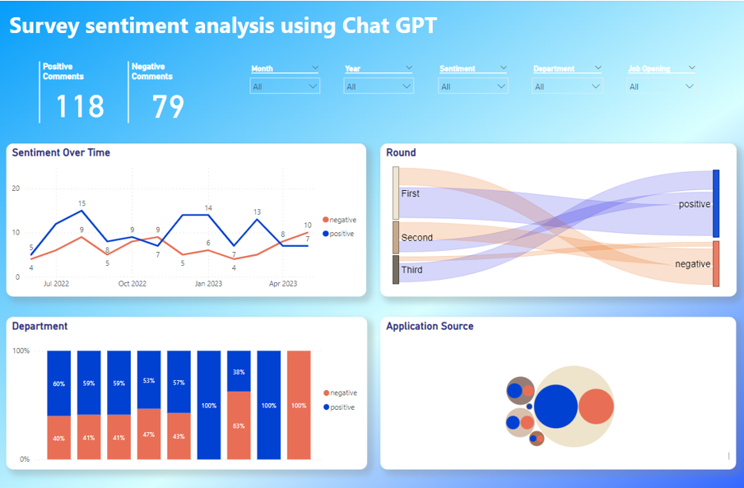
Assessing Candidates’ Experience through Sentiment Analysis
Uncovering Candidates Feedback Sentiment
Leveraging pre-trained RoBERTa Model
Optimizing input for the model by cleaning and pre-processing feedback data.
Fine-tuning the "sentiment-Roberta-large" model using labeled data to enhance its ability to handle nuances and provide more accurate sentiment analysis results aligned with client-specific requirements.
End-to-End Solution Deployment
Deploying an end-to-end solution by integrating the fine-tuned model into the client's ETL pipeline.
Dashboarding in Power BI for dynamic visualization of key insights, trends, and actionable feedback categories

Slide 11
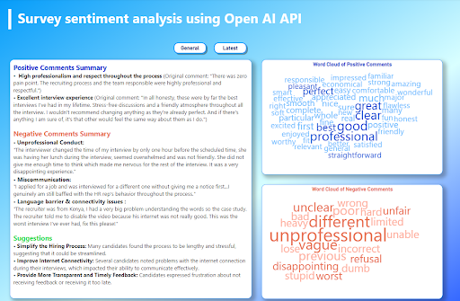
Assessing Candidates’ Experience through Sentiment Analysis
Highlighting Critical Insights
Creating Candidate Comment Embeddings
Tokenizing candidate comments using custom NLP techniques for analysis preparation.
Utilizing OpenAI's Embeddings API to generate high-dimensional vector representations for each candidate comment.
Extracting Insights with Text Summarization
Applying OpenAI GPT-3 API model to perform text summarization
Incorporating trained embeddings and defining specific summarization objectives to extract tailored insights from the text.
Customized Comment Selection
Instructing GPT-3 to prioritize comments related to specific topics specified by the client (e.g., discrimination, rudeness)
Applying custom filters and thresholds to fine-tune the categorization ensuring the inclusion of the most meaningful insights.

Slide 12
Geospatial Analysis of Labor Catchment: Assessing Employment and Demographic Patterns
Client Challenge
Our Solution
Outcome
The client needed to identify optimal locations for unemployment centers and accurately assessing the population in need and its characteristics.
The firm was looking for :
Infomineo’ s Data Analytics team addressed the client’s need by:
Indicator Identification
Selecting relevant criteria such as population statistics, socio-economic factors, and geographic boundaries.
Modelling
Calculation of the percentage area of each municipality within designated buffer zones based geographic coordinates.
Development of an algorithm that accounted for a homogeneous distribution of the population.
Geocoding & Visualization
Use of geocoding techniques to transform location data into precise geographical coordinates.
The client benefited from Infomineo Data Analytics service on multiple fronts:
Comprehensive KPI Insights
Delivered a report with averaged KPIs for each buffer zone (e.g., unemployment, educational background, and wages).
Seamless Data Exploration
Developed a user-friendly graphical interface that enables customized analyses.
Scalable Expansion Potential
The graphical interface could be expanded to cover additional European countries for future analysis.
Identifying the most relevant indicators and reliable data sources that will provide them with comprehensive insights.
Calculating the percentage area of each municipality and the estimated population within designated buffer zones based on specific geographic coordinates.
Visualizing the collected data into a geospatial to identify patterns, hotspot areas with higher needs, and make data-driven decisions regarding the optimal placement of our unemployment centers

Slide 13

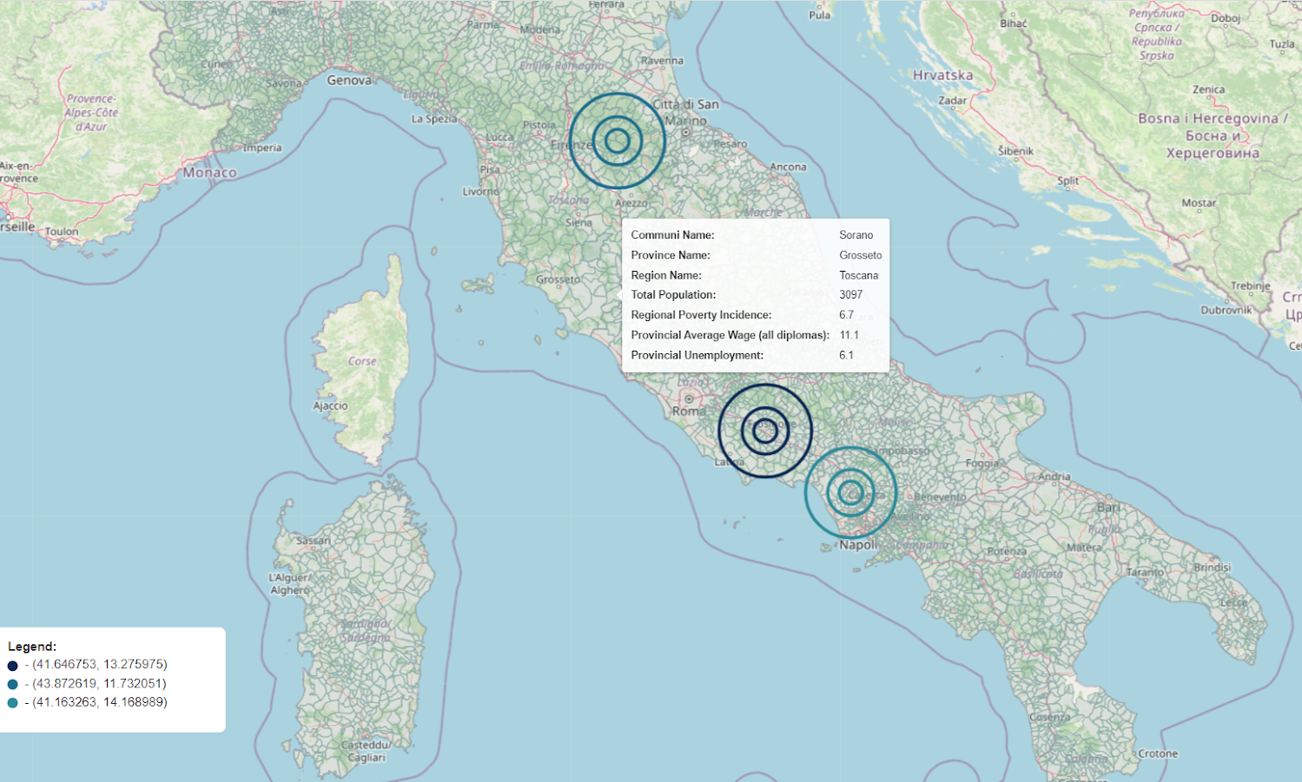
Geospatial Analysis of Labor Catchment: Assessing Employment and Demographic Patterns
Infomineo Approach
Extensive municipal data acquisition: Gather comprehensive data on municipality boundaries and population statistics.
Relevant Data Compilation: Compile additional data on unemployment rates, poverty levels, education background, and regional wages.
User-Friendly Interface: Develop a user-friendly interface for easy excel report requests and uploads. Users can efficiently extract relevant data by inputting specific locations or batches of coordinates for buffer zones.
Interactive Mapping: Create an interactive map that provides a visually immersive exploration of the collected data.

